Slide 1


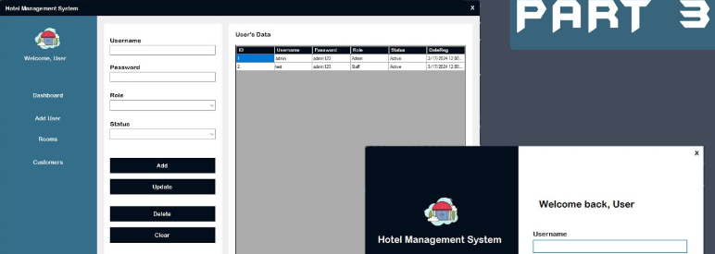



DATABASE MANAGEMENT SYSTEM
HOTEL "THE FOREST"
Core Goal: Robust relational database for reservation management the hotel.
Key Pillars:
Data Integrity (ACID)
Forensic Auditing (JSON)
Concurrency Control (No overbooking)
the_forest

Slide 2
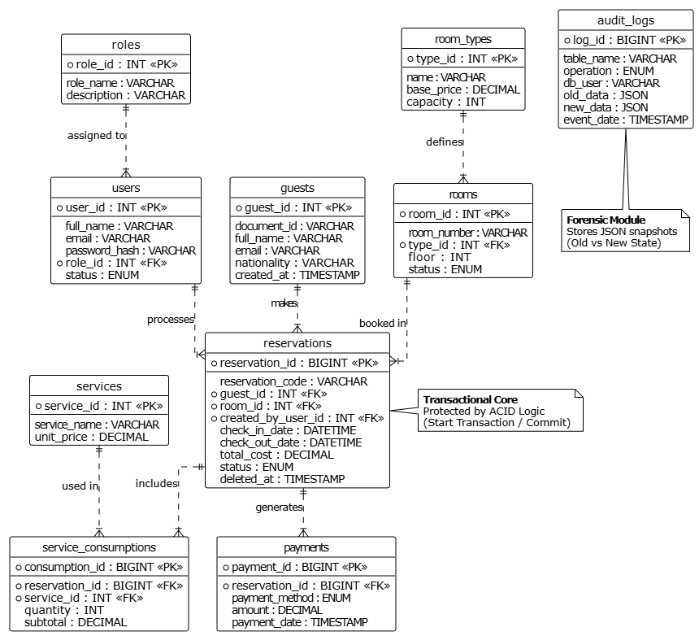
ARCHITECTURE & DATA DESIGN
Standards: 3rd Normal Form (3NF).
Main Entities: Reservations (Transactional), Guests (Master), Rooms (Master), Audit Logs (System).
Design Highlight: Separation of catalog tables (room_types, roles) to avoid redundancyArchitecture & Data Design
diagram_er

Slide 3
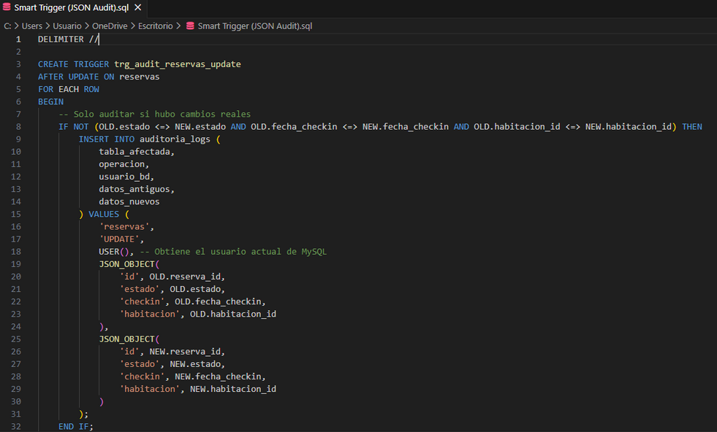
ADVANCED TECHNICAL IMPLEMENTATION
ACID Transactions:
START TRANSACTION -> LOCK (FOR UPDATE) -> COMMIT/ROLLBACK.
Intelligent Audit:
JSON Storage (Old_State vs New_State).
Soft Delete:
Preserving history with deleted_at.
trigger_

Slide 4
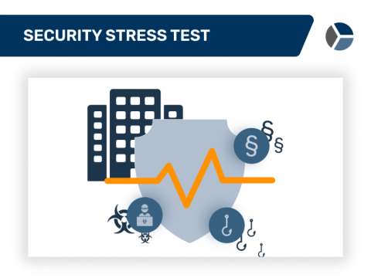
SECURITY, ROLES & STRESS TESTING
Security:
Principle of Least Privilege.
Receptionist: Operational access.
Auditor: Read-only access.
Stress Test Results:
1,200 Guests / 1,000 Reservations generated via Script.
Execution time: < 5 seconds.
Conclusion:
Scalable, secure, and production-ready.

